Slide 1
*
*
Understanding Accounting and Financial Information
Notes:
‹#›

Slide 2

ACCOUNTING VS. FINANCE

Slide 3
WHAT’S ACCOUNTING?
*
*
Accounting -- Recording, classifying, summarizing and interpreting of financial events and transactions in an organization to provide interested parties needed financial information.
Finance (Financial Management)-- It is concerned with the ways in which funds for a business are raised and invested.
17-‹#›

Slide 4
Sources of Funds
*
*
Debt Financing (External Sourcing)-- The funds raised through various forms of borrowing that must be repaid.
Equity Financing (internal Sourcing)-- The funds raised from within the firm from operations or through the sale of ownership in the firm (such as stock).
17-‹#›

Slide 5
Raise Funds
Use Funds
Owners, Lenders
Investments (Equipment, premises etc.)

Slide 6
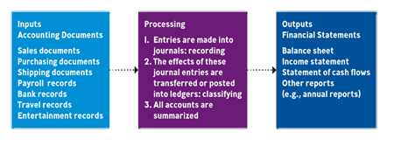
The ACCOUNTING SYSTEM
*
*
17-‹#›

Slide 7
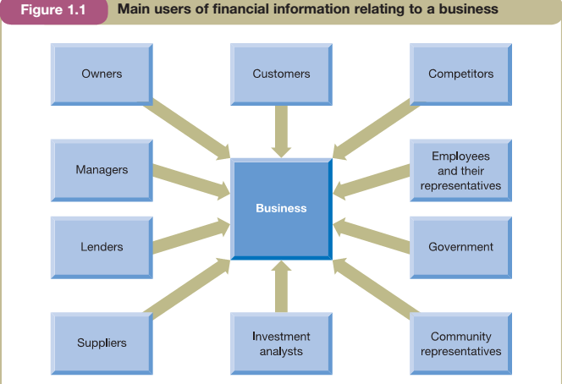
Who are the users of Accounting Information
The accountant must be clear for whom the information is being prepared and for what purpose the information will be used.

Slide 8
The conflicting interest of users
Interest of various groups may collide
Although managers are appointed to act in the best interests of the owners, they may not always do so.
There is also a potential collision of interest between lenders and owners

Slide 9
Management Accounting & Financial Accounting
Management accounting - seeks to meet the accounting needs of managers
Financial accounting- seeks to meet those of all of the users identified earlier in except for managers

Slide 10
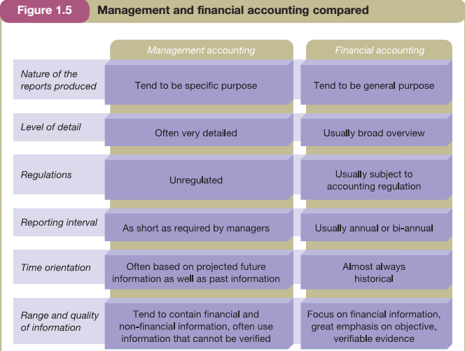
Management & Financial Accounting

Slide 11

FINANCIAL STATEMENTS
*
Understanding Key Financial Statements
*
LG3
Financial Statement -- A summary of all the financial transactions that have occurred over a particular period.
Key financial statements of business are:
Statement of financial position (Balance sheet)
Income statement (known as profit and loss account)
Statement of cash flows
Statement of Shareholder’s Equity
17-‹#›

Slide 12
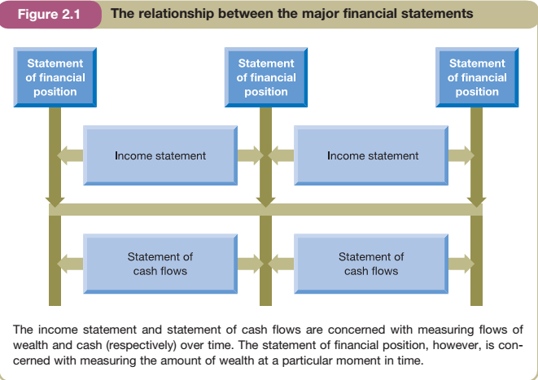

Slide 13
The Income statement
Revenue: simply a measure of the inflow of economic benefits arising from the ordinary operations of a business.
Some examples
Sales of Goods
Fees for services
Subscriptions
Interest received
Cost of Sales: how much it costs to produce a good or service

Slide 14
The Income statement
Operating Expenses
Depreciation: depreciation is an attempt to measure that portion of the cost (or fair value) of a non-current asset that has been depleted in generating the revenue recognized during a particular period.

Slide 15
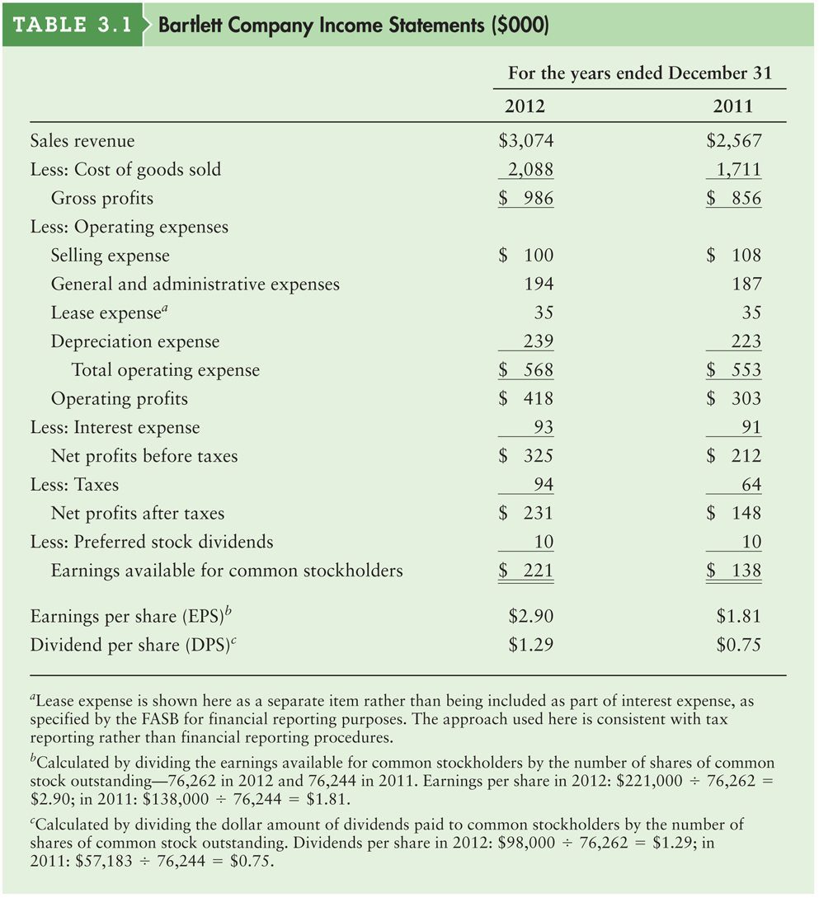
Table 3.1 Bartlett Company Income Statements ($000)

Slide 16
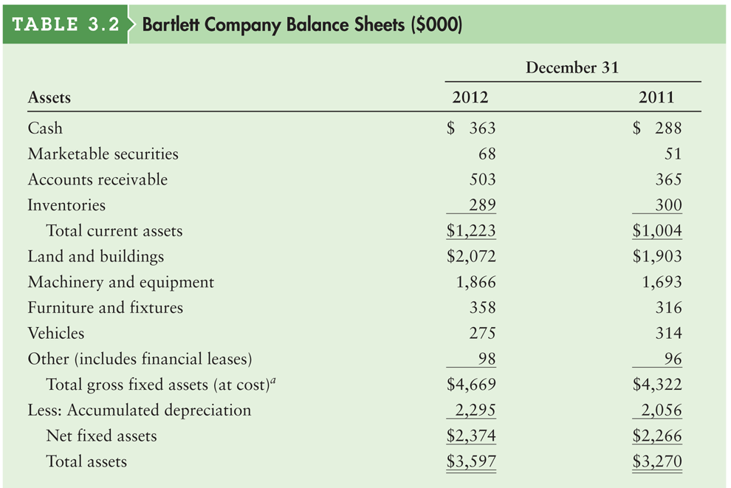
Table 3.2a Bartlett Company Balance Sheets ($000)

Slide 17
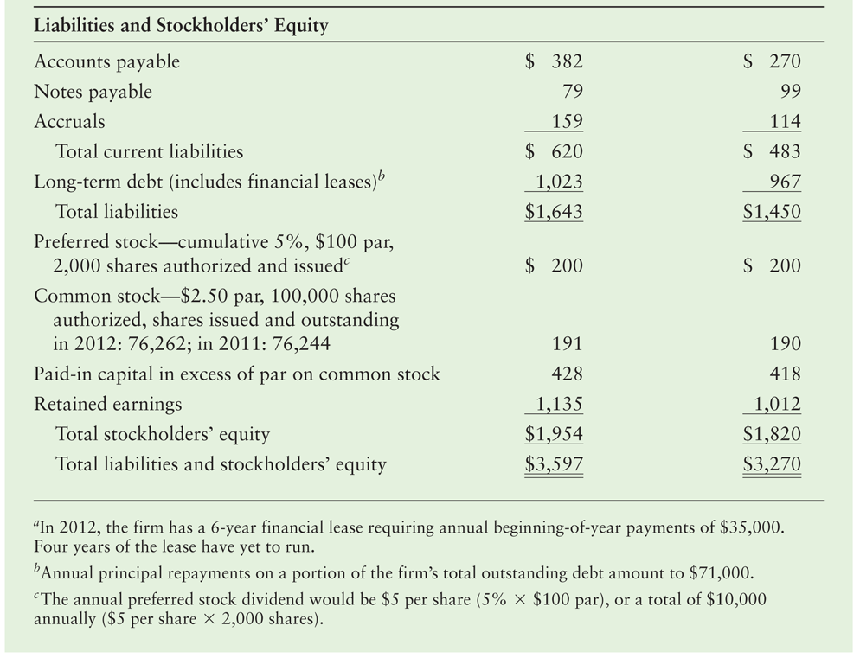
Table 3.2b Bartlett Company Balance Sheets ($000)

Slide 18
The FUNDAMENTAL ACCOUNTING EQUATION
*
The Fundamental Accounting Equation
*
LG4
Fundamental Accounting Equation -- The basis for the balance sheet.
The equation must always be balanced and includes the formula:
Assets = Liabilities + Owners Equity
17-‹#›
Notes:
‹#›

Slide 19
Assets
A probable future economic benefit must exist
The benefit must arise from some past transaction or event
The business must have the right to control the resource
The asset must be capable of measurement in monetary terms

Slide 20
Assets
Tangible Assets (Inventories)
Intangible assets (Patents)

Slide 21
Asset classification
Current assets are basically assets that are held for the short term. (Ex. Cash, trade receivables, inventories)
Non-current assets(also called fixed assets) are simply assets that do not meet the definition of current assets. They tend to be held for long-term operations. (Ex. property, plant, equipment)

Slide 22
Claims
Equity - represents the claim of the owner(s) against the business. This claim is sometimes referred to as the owner’s capital
Liabilities – claim of outsiders
- Current liabilities are basically amounts due for settlement in the short term. (Ex. short term loans)
- Non-current liabilities represent longer-term liabilities.

Slide 23

USING FINANCIAL RATIOS
*
*
Ratio Analysis -- The assessment of a firm’s financial condition using calculations and financial ratios developed from the firm’s financial statements.
Key ratios include:
Liquidity ratios
Leverage ratios
Performance ratios
Activity ratios
17-‹#›
Notes:
‹#›

Slide 24

COMMONLY USED LIQUIDITY RATIOS
*
Liquidity Ratios
*
LG5
Liquidity ratios measure a firm’s ability to turn assets into cash to pay its short-term debts.
Two key ratios are:
Current ratio
Acid-test ratio
This information is found on the firm’s balance sheet.
17-‹#›
Notes:
‹#›

Slide 25

LEVERAGE RATIOS
*
Leverage (Debt) Ratios
*
LG5
Leverage ratios measure the degree to which a firm relies on borrowed funds in its operations.
Key ratios include:
Debt to Owner’s Equity Ratio
This information is found on the firm’s balance sheet.
17-‹#›
Notes:
‹#›

Slide 26


PROFITABILITY RATIOS
*
Profitability (Performance) Ratio
*
LG5
Profitability ratios measure how effectively a firm’s managers are using it various resources to achieve profits.
Key ratios include:
Basic earnings per share
Return on sales
Return on equity
17-‹#›
Notes:
‹#›

Slide 27

ACTIVITY RATIOS
*
Activity Ratio
*
LG5
Activity ratios measure how effectively management is turning over inventory
Key ratios include:
Inventory turnover ratio
This information is found on the firm’s balance sheet and income statement.
17-‹#›
Notes:
‹#›

